Slide 1
Exam Preparation
Price Ceiling & Price flooring
Normative and Positive
Numerical Demand and Supply
Visualize the different events

Slide 2
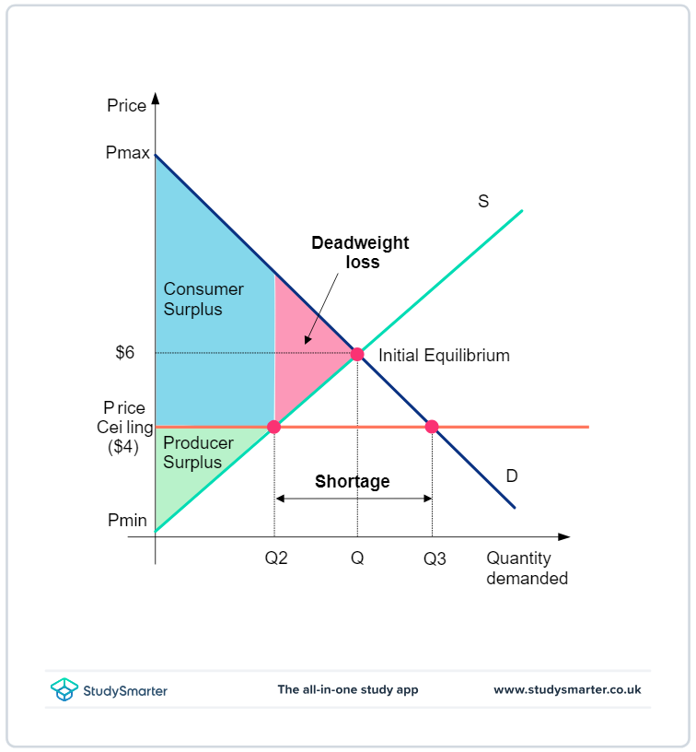
Price Ceiling
Page 74 - Perloff

Slide 3
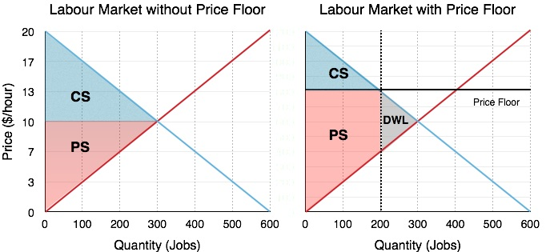
Price Flooring
Page 76 -Perloff

Slide 4
Normative and Positve
Economic Development: While Pakistan's economy is growing, it should be more focused on reducing poverty levels.
Positive: The economy is growing.
Normative: It should focus on poverty reduction.
Healthcare Access: Although healthcare facilities have increased in urban areas, it is necessary for the government to ensure that rural populations receive adequate medical services.
Positive: Healthcare facilities are increasing in urban areas.
Normative: The government must ensure rural access.
Cultural Heritage: Pakistan has a rich cultural heritage that ought to be better preserved for future generations, even though many historical sites are currently in disrepair.
Positive: There is a rich cultural heritage.
Normative: Historical sites ought to be preserved.
Political Stability: Despite ongoing political unrest, it is essential for political leaders to prioritize national unity to achieve lasting stability.
Positive: There is ongoing political unrest.
Normative: Political leaders should prioritize national unity.

Slide 5
Numerical Demand and Supply
See Handout / Hard Copy

Slide 6
Visualize the different events
See Handout / Hard Copy

